Slide 1




The HTTP Protocol
HTTP, Requests, Responses, Forms, MIME, Caching, Redirects
Web Development Basics
SoftUni Team
Technical Trainers
Software University
http://softuni.bg

Slide 2


Table of Contents
HTTP Overview, HTML Forms, GET, POST, Action
WWW, URL, Web Servers, Web Browsers
MIME and Media Types
HTML Forms, GET, POST and Encryption Types
HTTP Requests, Headers, Responses, Response Codes
Caching: cache-control, ETag, ...
Uploading Files through HTTP POST
Downloading Files: Content-Type and Content-Disposition

Slide 3



World Wide Web
What is WWW?

Slide 4
What is World Wide Web (WWW)?
WWW = World Wide Web = Web != Internet
Internet is a global system of interconnected computer networks
WWW is one of the services running in these networks
Global distributed information system in Internet (like E-mail, DNS, ...)
Consists of set of resources (documents, images and others)
Located at different Internet servers, identified by URL
Accessed through standard protocols (like HTTP, HTTPS, FTP) by URL
Web servers provide Web content through the HTTP protocol
Web browsers access the Web content and display it

Slide 5
WWW Components
The HTTP protocol is fundamental for WWW
WWW structural components
Internet – provides data transfer channels over the TCP and HTTP
Web servers (Apache, IIS, Tomcat, Nginx, GWS, etc.) – serve HTTP
Clients (Web browsers) – download and display HTTP resources
WWW semantic components
Hyper Text Transfer Protocol (HTTP) and other protocols
Uniform Resource Locator (URL), Uniform Resource Identifiers (URI)
Hyper Text Markup Language (HTML), Cascading Stylesheets (CSS)

Slide 6

The Structure of URLs
Uniform Resource Locator

Slide 7
Uniform Resource Locator (URL)
http://mysite.com:8080/demo/index.php?id=27&lang=en#lectures
Protocol
Host
Port
Path
Query String
Fragment
URL is a formatted string, consisting of:
Protocol for communicating (http, ftp, https...) – HTTP in most cases
Host or IP address (www.softuni.bg, gmail.com, 127.0.0.1, web)
Port (the default port is 80) – a number in range [0…65535]
Path (/forum, /path/index.php)
Query string (?id=27&lang=en)
Fragment (#lectures) – used on the client to navigate to some section

Slide 8
URL Encoding
URLs are encoded according RFC 1738:
Safe URL characters: [0-9a-zA-Z], $, -, _, . , +, *, ', (, ), ,, !
All other characters are escaped by:
Space is encoded as "+" or "%20"
Example:
URL-encoded string:
Char | URL Encoding
space | %20
щ | %D1%89
" | %22
# | %23
$ | %24
% | %25
& | %26
%[character hex code]
Наков-爱-SoftUni
%D0%9D%D0%B0%D0%BA%D0%BE%D0%B2-%E7%88%B1-SoftUni

Slide 9
Valid and Invalid URLs – Examples
Some valid URLs:
Some invalid URLs:
http://www.google.bg/search?sourceid=navclient&ie=UTF-8&rlz=1T4GGLL_enBG369BG369&q=http+get+vs+post
http://bg.wikipedia.org/wiki/%D0%A1%D0%BE%D1%84%D1%82%D1%83%D0%B5%D1%80%D0%BD%D0%B0_%D0%B0%D0%BA%D0%B0%D0%B4%D0%B5%D0%BC%D0%B8%D1%8F
Should be: ?q=C%23+.NET+4.0
http://www.google.bg/search?&q=C# .NET 4.0
Should be: ?q=%D0%B1 %D0%B8%D1%80%D0%B0
http://www.google.bg/search?&q=бира

Slide 10
URL Encoding / Decoding in PHP
Use urlencode(string) / urldecode(string):
$text = "Some text / някакъв текст";
$urlEncodedText = urlencode($text);
echo $urlEncodedText;
Some+text+%2F+%D0%BD%D1%8F%D0%BA%D0%B0%D0%BA%D1%8A%D0%B2+%D1%82%D0%B5%D0%BA%D1%81%D1%82
$decodedText = urldecode($urlEncodedText);
echo $decodedText;
Some text / някакъв текст

Slide 11
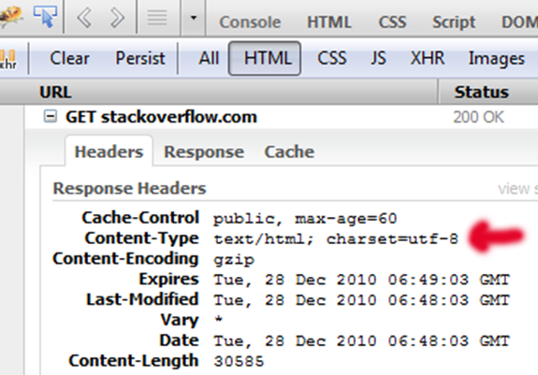

MIME and Media Types
Multi-Purpose Internet Mail Extensions

Slide 12
What is MIME?
MIME == Multi-Purpose Internet Mail Extensions
Internet standard for encoding resources
Originally developed for email attachments
Used in many Internet protocols like HTTP and SMTP
MIME defines several concepts
Content-Type, e.g. text/html, image/gif, application/pdf
Content charset, e.g. utf-8, ascii, windows-1251
Content-Disposition, e.g. attachment; filename=logo.jpg
Multipart messages (multiple resources in a single document)

Slide 13
Common MIME Media Types
MIME Type / Subtype | Description
application/json | JSON data
image/png | PNG image
image/gif | GIF image
text/html | HTML
text/plain | Text
text/xml | XML
video/mp4 | MP4 video
application/pdf | PDF document

Slide 14
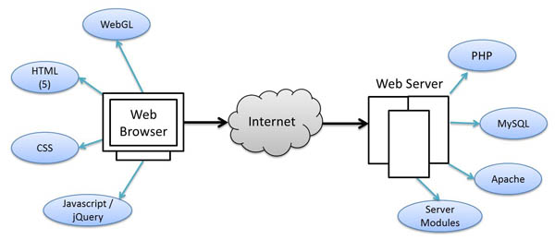
How Browsers Open a Web Page?
DNS Resolve, Connect, HTTP Request, …

Slide 15
Opening a Web Page: Step by Step
How browsers open a URL like http://www.w3.org/standards/
Resolve the host name (www.w3.org) through the DNS system
Open a TCP connection to the Web server (128.30.52.37, port 80)
Make a HTTP GET request for the requested page: /standards/
Retrieve the HTTP response, typically a HTML document
Parse the HTML and extract the related CSS, JavaScript and images
Make subsequent HTTP GET requests to load the CSS, JS and images
Render the Web page in the browser (visualize the HTML and CSS)

Slide 16
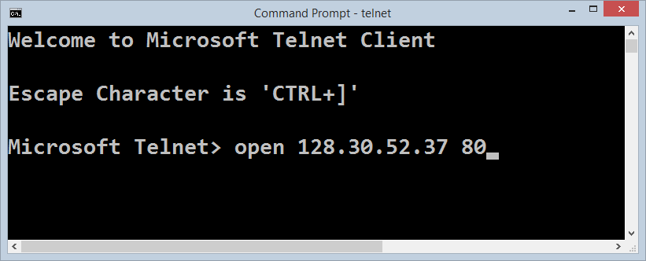
Opening a Web Page through the Console with Telnet
Live Demo

Slide 17
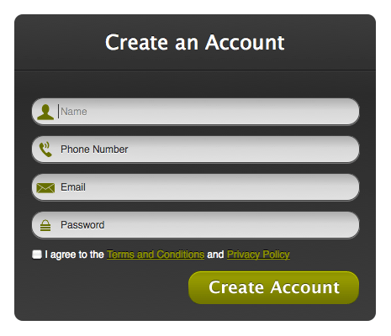
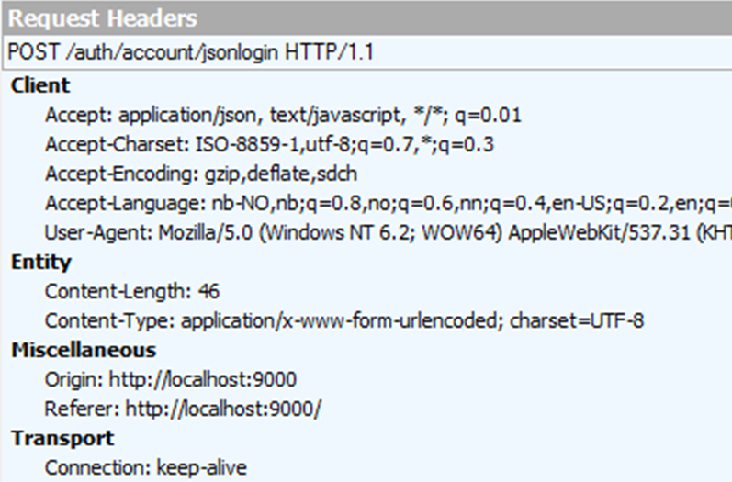
HTML Forms and HTTP
GET, POST, Action, Enc-Type, …

Slide 18
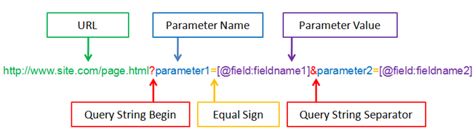
The URL Query String
The URL query string holds the HTTP request parameters
Typically used in GET requests

Slide 19
Query String in PHP
A query string is the part of a URL following a question mark (?)
Commonly used in searches and dynamic pages
Accessed in PHP through $_SERVER['QUERY_STRING']
<form>
<input type="text" name="firstName" />
<input type="submit" />
</form>
<?php
echo $_SERVER['QUERY_STRING'];
?>

Slide 20

GET Request Method
HTTP GET
Retrieves data from the client HTTP request URL
In PHP the form data accessed through $_GET['variable']
The data sent by GET method can be accessed through $_SERVER['QUERY_STRING']
<form method="get" action="index.php">
…
</form>

Slide 21
GET Request Method – Example
<form method="get">
Name: <input type="text" name="name" />
Age: <input type="text" name="age" />
<input type="submit" />
</form>
<?php
// Check the keys "name" or "age" exist
if (isset($_GET["name"]) || isset($_GET["age"])) {
echo "Welcome " . htmlspecialchars($_GET['name']) . ". <br />";
echo "You are " . htmlspecialchars($_GET['age']). " years old.";
}
?>

Slide 22

POST Request Method
The POST method transfers data in the HTTP body
Not appended to the query string
The posted data is stored in $_POST associative array
Using htps:// you can protect your posted data with SSL
POST can send text and binary data, e.g. upload files
<form method="post" action="index.php">
…
</form>

Slide 23
POST Request Method – Example
<form method="post">
Name: <input type="text" name="name" />
Age: <input type="text" name="age" />
<input type="submit" />
</form>
<?php
// Check the keys "name" or "age" exist
if (isset($_POST["name"]) || isset($_POST["age"])) {
echo "Welcome " . htmlspecialchars($_POST['name']) . ". <br />";
echo "You are " . htmlspecialchars($_POST['age']). " years old.";
}
?>

Slide 24
HTML Forms: GET vs. POST
Live Demo

Slide 25
Form Encryption Type
HTML forms can be submitted in two formats:
application/x-www-form-urlencoded
Form fields are encoded like a URL query string, e.g. lang=en&p=12
File uploads are not supported
multipart/form-data
Each form fields is posted with headers + name + value
A special boundary identifier is used to separate between fields
Supports file upload

Slide 26
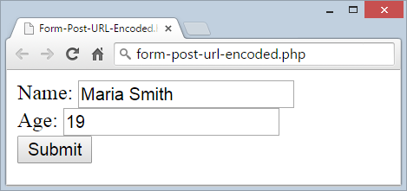
URL Encoded Form Data – Example
<form method="post" action="/index.php">
Name: <input type="text" name="name" value="Maria Smith" />
<br/>Age: <input type="text" name="age" value="19" /><br/>
<input type="submit" />
</form>
POST /index.php HTTP/1.1
Host: localhost:5555
Content-Type: application/x-www-form-urlencoded
name=Maria+Smith&age=19

Slide 27
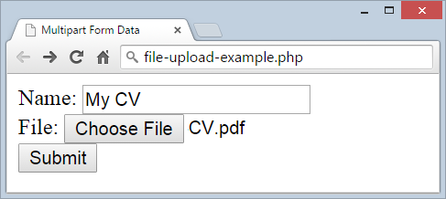
Multi-Part Form Data: Sample Form
<form method="post" enctype="multipart/form-data"
action="api/upload">
Name: <input type="text" name="name" value="My CV" />
<br/>
File: <input type="file" name="attachment" />
<br/>
<input type="submit" />
</form>

Slide 28
Multi-Part Form Data: Sample POST Request
POST http://localhost:5555/api/upload HTTP/1.1
Content-Type: multipart/form-data; boundary=pmVO5c0aBS
--pmVO5c0aBS
Content-Disposition: form-data; name="name"
My CV
--pmVO5c0aBS
Content-Disposition: form-data; name="attachment"; filename="CV.pdf"
Content-Type: application/pdf
%PDF-1.5
%µµµµ
(… more binary data comes here …)
--pmVO5c0aBS--

Slide 29
Form URL Encoded vs. Multipart Form Data
Live Demo

Slide 30



The HTTP Protocol
HTTP
How HTTP Works?

Slide 31
HTTP
HTTP == Hyper Text Transfer Protocol
Client-server protocol for transferring Web resources (HTML files, images, styles, scripts, data, etc.)
The widespread protocol for Internet communication today
Request-response model (client requests, server answers)
Text-based format (human readable)
Relies on unique resource URLs
Provides resource metadata (e.g. encoding)
Stateless (cookies and Web storages can overcome this)

Slide 32


HTTP: Request-Response Protocol
Client program
Running at end host
Requests a resource
Server program
Running at the server
Provides resources
HTTP Request
HTTP Response
HTTP Client
HTTP Server

Slide 33
HTTP Conversation: Example
GET /courses/javascript HTTP/1.1
Host: www.softuni.bg
User-Agent: Mozilla/5.0
<CRLF>
HTTP request:
HTTP response:
The empty line denotes the end of the request header
HTTP/1.1 200 OK
Date: Mon, 5 Jul 2010 13:09:03 GMT
Server: Microsoft-HTTPAPI/2.0
Last-Modified: Mon, 12 Jul 2014 15:33:23 GMT
Content-Length: 54
<CRLF>
<html><title>Hello</title>
Welcome to our site</html>
The empty line denotes the end of the response header

Slide 34
HTTP Request Methods
HTTP defines request methods
Specify the action to be performed on the identified resource
Method | Description
GET | Retrieve a resource (execute query)
POST | Creates a resource
PUT | Modifies a resource
DELETE | Remove (delete) a resource
HEAD | Retrieve the resource's headers
OPTIONS | Requests communication options

Slide 35



HTTP Request Message

Slide 36
HTTP Request Message
Request message sent by a client consists of:
HTTP request line
Request method (GET / POST / PUT / DELETE / …)
Resource URI (URL)
Protocol version
HTTP request headers
Additional parameters
HTTP body – optional data, e.g. posted form fields
<method> <resource> HTTP/<version>
<headers>
(empty line)
<body>

Slide 37
HTTP GET Request – Example
Example of HTTP GET request:
HTTP request line
GET /courses/javascript HTTP/1.1
Host: www.softuni.bg
Accept: */*
Accept-Language: bg
Accept-Encoding: gzip, deflate
User-Agent: Mozilla/4.0(compatible;MSIE 6.0;Windows NT 5.0)
Connection: Keep-Alive
Cache-Control: no-cache
<CRLF>
HTTP request headers
The request body is empty

Slide 38
HTTP POST Request – Example
Example of HTTP POST request:
HTTP request line
POST /webmail/login.phtml HTTP/1.1
Host: www.abv.bg
Accept: */*
Accept-Language: bg
Accept-Encoding: gzip, deflate
User-Agent: Mozilla/4.0(compatible;MSIE 6.0; Windows NT 5.0)
Connection: Keep-Alive
Cache-Control: no-cache
Content-Length: 59
<CRLF>
username=mente&password=top*secret!
<CRLF>
HTTP request headers
The request body holds the submitted form data

Slide 39
Conditional HTTP GET – Example
Example of HTTP conditional GET request:
Fetches the resource only if it has been changed at the server
Server replies with "304 Not Modified" if the resource has not been changed
Or "200 OK" with the latest version otherwise
GET /apply HTTP/1.1
Host: www.softuni.bg
User-Agent: Gecko/20100115 Firefox/3.6
If-Modified-Since: Tue, 9 Mar 2015 11:12:23 GMT
<CRLF>

Slide 40

HTTP Response Message

Slide 41
HTTP Response Message
The response message sent by the HTTP server consists of:
HTTP response status line
Protocol version
Status code
Status phrase
Response headers
Provide meta data about the returned resource
Response body
The content of the HTTP response (data)
HTTP/<version> <status code> <status text>
<headers>
<CRLF>
<response body – the requested resource>

Slide 42
HTTP Response – Example
Example of HTTP response from the Web server:
HTTP response status line
HTTP/1.1 200 OK
Date: Fri, 17 Jul 2010 16:09:18 GMT+2
Server: Apache/2.2.14 (Linux)
Accept-Ranges: bytes
Content-Length: 84
Content-Type: text/html
<CRLF>
<html>
<head><title>Test</title></head>
<body>Test HTML page.</body>
</html>
HTTP response headers
The HTTP response body

Slide 43
HTTP Response – Example
Example of HTTP response with error result:
HTTP response status line
HTTP/1.1 404 Not Found
Date: Fri, 17 Nov 2014 16:09:18 GMT+2
Server: Apache/2.2.14 (Linux)
Connection: close
Content-Type: text/html
<CRLF>
<HTML><HEAD>
<TITLE>404 Not Found</TITLE>
</HEAD><BODY>
<H1>Not Found</H1>
The requested URL /img/logo.gif was not found on this server.<P>
<HR><ADDRESS>Apache/2.2.14 Server at Port 80</ADDRESS>
</BODY></HTML>
HTTP response headers
The HTTP response body

Slide 44
HTTP Response Codes
HTTP response code classes
1xx: informational (e.g., "100 Continue")
2xx: successful (e.g., "200 OK", "201 Created")
3xx: redirection (e.g., "304 Not Modified", "301 Moved Permanently", "302 Found")
4xx: client error (e.g., "400 Bad Request", "404 Not Found", "401 Unauthorized", "409 Conflict")
5xx: server error (e.g., "500 Internal Server Error", "503 Service Unavailable")

Slide 45
Browser Redirection
HTTP GET requesting a moved URL:
The following HTTP response (301 Moved Permanently) tells the browser to request another URL:
GET / HTTP/1.1
Host: http://softuni.org
User-Agent: Gecko/20100115 Firefox/3.6
<CRLF>
HTTP/1.1 301 Moved Permanently
Location: http://softuni.bg
…

Slide 46
Content-Type and Disposition
The Content-Type response header the server specifies how the output should be processed
Examples:
UTF-8 encoded HTML page. Will be shown in the browser.
Content-Type: text/html; charset=utf-8
Content-Type: application/pdf
Content-Disposition: attachment; filename="Report-April-2010.pdf"
This will download a PDF file named Financial-Report-April-2010.pdf

Slide 47



Redirecting the Browser

Slide 48
Redirecting the Browser
Done by using the HTTP "Location" header
This sends HTTP 302 "Found" in the HTTP response status code
Tells the browser to open a new URL
header('Location: http://softuni.bg');

Slide 49


HTTP Compression
Using Deflate and GZIP with HTTP

Slide 50
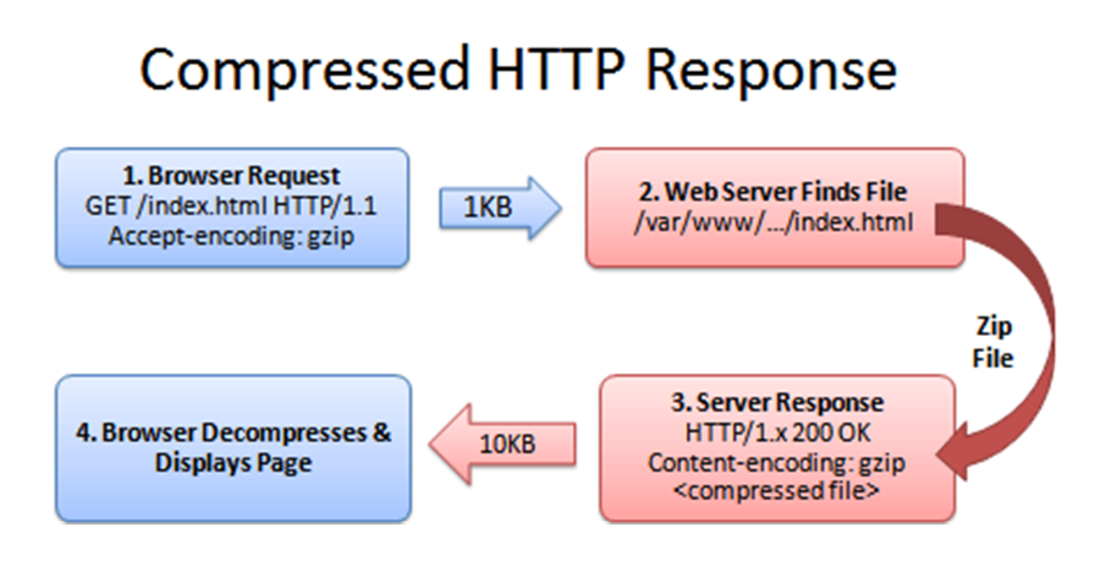
HTTP Compression: How It Works?

Slide 51
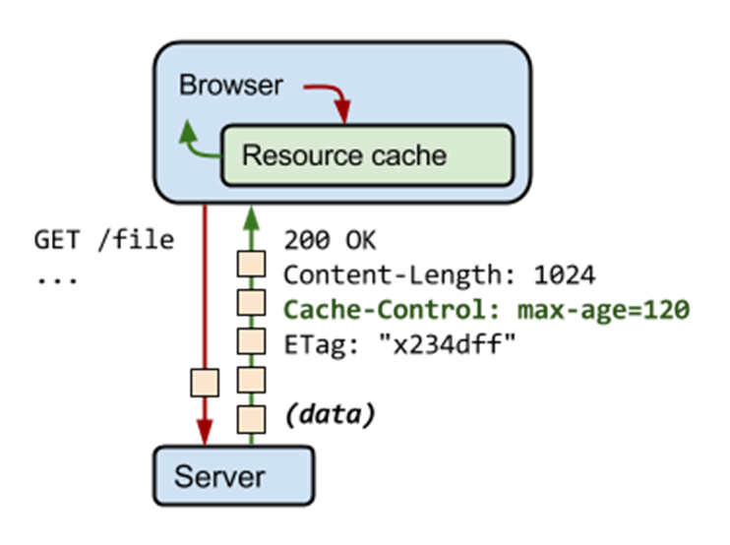

Caching HTTP Resources
Cache Control HTTP Headers

Slide 52
HTTP Caching
HTTP cache control tags:
Cache-Control (no-cache, max-age, public, private, …)
ETag, Last-Modified
Expires, Last-Modified
If-Modified-Since

Slide 53










The HTTP Protocol
https://softuni.bg/courses/web-development-basics/

Slide 54
License
This course (slides, examples, demos, videos, homework, etc.) is licensed under the "Creative Commons Attribution-NonCommercial-ShareAlike 4.0 International" license

Slide 55





Free Trainings @ Software University
Software University Foundation – softuni.org
Software University – High-Quality Education, Profession and Job for Software Developers
softuni.bg
Software University @ Facebook
facebook.com/SoftwareUniversity
Software University @ YouTube
youtube.com/SoftwareUniversity
Software University Forums – forum.softuni.bg

